Slide 1
http://www.vidyanidhi.com/
ketkiacharya.net@gmail.com
Ketki Acharya
From: SM VITA ATC of CDAC
9769201036
ketkiacharya.net@gmail.com

Slide 2
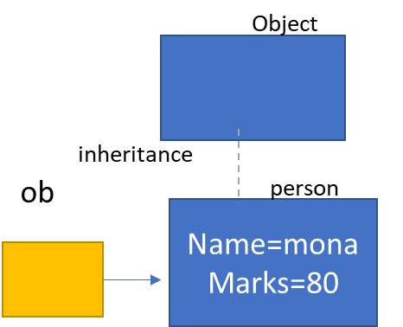
new Object()
<script>
var obj=new Object();
obj.name="vita";
obj.marks=90;
document.write(obj); //object Object
document.write(obj.constructor); //function Object
</script>
Object
obj
name=vita
marks=90
Function can also represent as class
Literal object
function person(nm,mks)
{
alert(this)
this.name=nm
this.marks=mks
}
var ob=new person("mona",80);//
<script>
var obj={name:"raj“,”2division”:”A” } //this is literal object
obj.marks=80 //adding instance member
</script>
Object
obj
name=raj
[“2division”]=A
marks=80

Slide 3
Literal object
Object
<script>
var obj={name:"raj“,”2division”:”A” } //this is literal object
obj.marks=80 //adding instance member
alert(obj); // object Object
document.write(obj.constructor); //function Object
document.write(obj.name + “ “ + obj[“2division”]);
</script>
In literal object we use colon : to assign value to instance member. var obj={"name":"raj“ }
We can directly add instance member to the class like this obj.marks=80
which constructor will it call?
It is instance of Object class so it will call constructor of Object class (function)
alert(obj); // object Object
As we know when you print object it will Call ToString() method.
If instance member variable name is not as per rule of variable then enclosed it in “” and you can use it with following syntax
obj[“2division”]);
obj
name=raj
[“2division”]=A
marks=80

Slide 4
Function can also represent as class
Object
//userdefine object
function person(nm,mks)
{
alert(this)
this.name=nm;
this.marks=mks;
}
var ob=new person("mona",80);// control will go to function
document.write(ob); //object Object
document.write(ob.constructor); //function Person
document.write("<hr/>")
document.write(ob.name+" "+ob["name"])
document.write("<hr/>")
for(let pp in ob)
document.write(pp+" "+ob[pp]);
document.write(ob instanceof person);//true
document.write(ob instanceof Object);//true
var ob1=new person(“Geeta",900);//
inheritance
ob
person
Name=mona
Marks=80
In java script function it self is class and it act as constructor also.
ob=new person("mona",80);//from this line ---control will go to function definition and it will initialized the instance member--- name and marks.
alert(this) //this refer to current object here it will object Object
Do I have to use this to initialise instance member ???
Yes in our example when we use this.name we says that name is instance variable with reference to class(function) person.
Can I write only name ? No if you want to represent as instance member this is must.

Slide 5
document.write(ob); //object Object
Recollect we have studied in .Net that when you print object internally it is calling ToString() method.
But person class(function) do not have ToString() method?
Yes. Recollect if method is not found in class(function) then control will go to parent class and here Object is a parent class so Object class ToString method get called.
So it is printing object Object here 1st object is data type and second Object is name of class(function)
document.write(ob.constructor); //function Person
Here constructor is a key word. We are checking it is calling which constructor?
It will print full person function definition
document.write(ob.name+" "+ob["name"])
By default all member of class(function) are public. So it will allow you to access name instance member out side the class(function)
In JS you can also use instance member as index value ie ob["name"] observe name is written in “ ” it is representing value at this key.
for(pp in ob)
document.write(pp+" "+ob[pp]);
in JS you can iterate over the instance member using for in
This loop will fetch instance member from ob[reference] and store it in variable pp
So it will print name mona
marks 80
document.write(ob instanceof person); document.write(ob instanceof Object);
Above both line will print true [it is same as instanceof key word in java]
Ob is instance if person class[function]

Slide 6
the differences: constructor object and literal object
The constructor object has its properties and methods defined with the keyword 'this' in front of it, whereas the literal version does not.
In the constructor object the properties/methods have their 'values' defined after an equal sign '=' whereas in the literal version, they are defined after a colon ':'.
The constructor function can have (optional) semi-colons ';' at the end of each property/method declaration whereas in the literal version if you have more than one property or method, they MUST be separated with a comma ',', and they CANNOT have semi-colons after them, otherwise JavaScript will return an error.
You can create multiple object for constructor object
You create only one object in literal object. Just for display and temporary use.

Slide 7
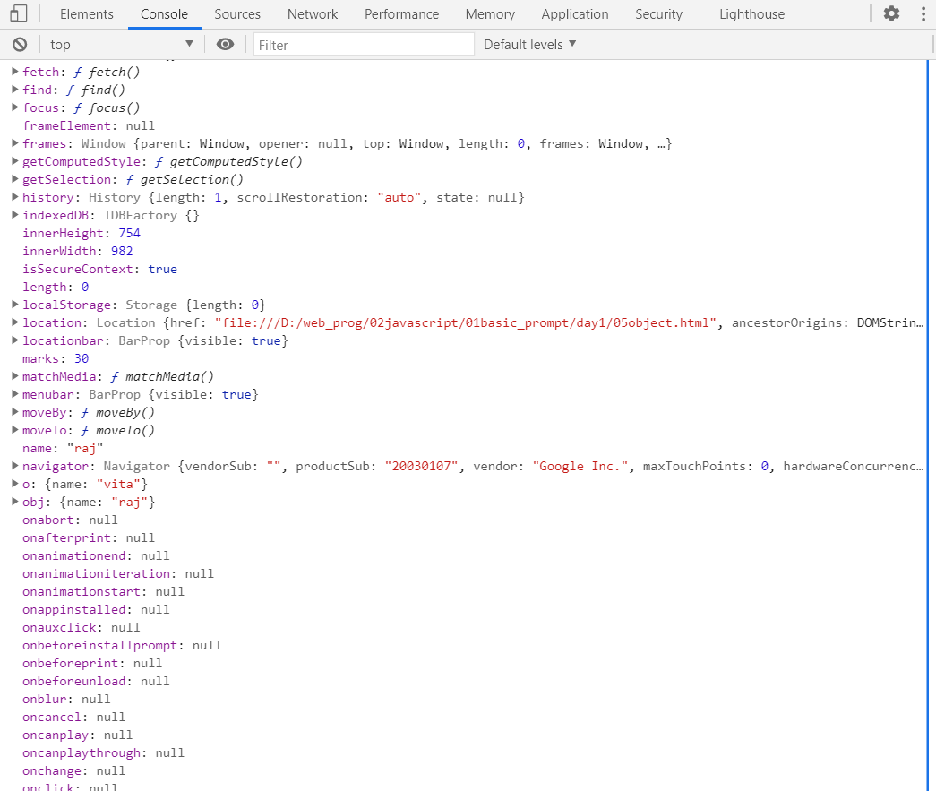
Can we call directly person(“mona”,80) without new key word?
Yes. That is the biggest problem in JS.
When you call without new key word it will call it with reference to window object. And name and marks will be set as instance member in window class
//userdefine object
function person(nm,mks)
{
alert(this)//it will display Window[native code]
this.name=nm
this.marks=mks
}
person(“raj”,30);
document.write(window.name);
console.log(window);

Slide 8
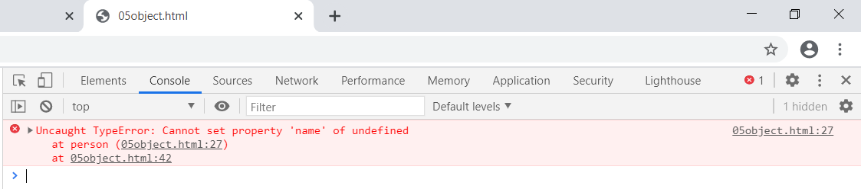
Re run this code by adding following line
“use strict”
When you add this line in that case
alert(this)// undefined
Here “this” will be undefined and it will not add instance member to window class. In fact It will give error and will not allow you to call directly person(“mona”,80) without new key word
“use strict”
//userdefine object
function person(nm,mks)
{
alert(this)//it will display undefined
this.name=nm
this.marks=mks
}
person(“mona”,80);
document.write(window.name);
console.log(window);
Calling as functions

Slide 9
Shallow Copy
Object
cpy
‘use strict’
function person(nm,mks)
{
alert(this)
this.name=nm
this.marks=mks
}
var ob=new person("mona",80);// control will go to function
document.write(ob); //object Object
document.write(ob.constructor); //function Person
document.write("<hr/>")
Var cpy=ob;
document.write(ob.name+" "+ob["name"])
document.write(cpy.name+" "+cpy["name"])
cpy.name=“geeta”
document.write("<hr/>")
for(let pp in ob)
document.write(pp+" "+ob[pp]);
document.write(ob instanceof person);//true
document.write(ob instanceof Object);//true
inheritance
person
ob
name=mona
marks=80
Geeta
In java script function it self is class and it act as constructor also.
ob=new person("mona",80);//from this line ---control will go to function definition and it will initialized the instance member--- name and marks.
alert(this) //this refer to current object here it will object Object
Do I have to use this to initialise instance member ???
Yes in our example when we use this.name we says that name is instance variable with reference to class(function) person.
Can I write only name ? No if you want to represent as instance member this is must.

Slide 10
Object.assign() to create a clone of an object. It is Shallow copy
The Object.assign() static method copies all enumerable own properties from one or more source objects to a target object. It returns the modified target object.
const target = { a: 1, b: 2 };
const source = { b: 4, c: 5 };
const returnedTarget = Object.assign(target, source);
console.log(target);// Expected output: Object { a: 1, b: 4, c: 5 }
console.log(returnedTarget === target);// Expected output: true
returnedTarget
a: 1,
b: 4 c:5
a: 1,
b: 2
target
b: 4,
c:5
source

Slide 11
Object.assign() to create a clone of an object. It is Shallow copy
The Object.assign() static method copies all enumerable own properties from one or more source objects to a target object. It returns the modified target object.
const target = {};
const source = { b: 4, c: 5 };
const returnedTarget = Object.assign(target, source);
console.log(target);// Expected output: Object { b: 4, c: 5 }
console.log(returnedTarget === target);// Expected output: true
returnedTarget
b: 4,
c:5
target
b: 4,
c:5
source

Slide 12
{ 'name': 'Alex', 'address’:
'age': 43}
{ dd:’Juhu’}
user
const user = {
'name': 'Alex',
'address': {dd:juhu},
'age': 43
}
clone
{ 'name': 'Alex',
'address':
'age': 43}
returnedTarget
const clone= {};
const returnedTarget = Object.assign(clone,user);
{ 'name': 'Alex', 'address’:
'age': 43}
{ dd:’Juhu’}
user
user.address.dd=“Andheri”
Clone.address.dd➔
clone
Andheri
{ 'name': 'Alex',
'address':
'age': 43}

Slide 13
Clone object using spread
Add Properties to Objects
const user = {
'name': 'Alex',
'address': '15th Park Avenue',
'age': 43
}
const clone = {...user} // Output, {name: "Alex", address: "15th Park Avenue", age: 43}
clone === user; // Output, false
const user = {
'name': 'Alex',
'address': '15th Park Avenue',
'age': 43
}
// Add a new property salary
const updatedUser = {...user, salary:12345}; // {name: "Alex", address: "15th Park Avenue", age: 43, salary: 12345}
// Original object is unchanged
console.log(user); // {name: "Alex", address: "15th Park Avenue", age: 43}
{ 'name': 'Alex', 'address': '15th Park Avenue', 'age': 43}
user
{ 'name': 'Alex', 'address': '15th Park Avenue', 'age': 43}
clone
Update Properties
You can alternatively use object.assign() to create a clone of an object. However, the spread syntax is much more precise and much shorter.
The spread syntax performs a shallow copy of the object. This means that none of the nested object instances are cloned.
const user = { 'name': 'Alex',
'address': '15th Park Avenue',
'age': 43 }
const updatedUser = {...user, age:56}; // {name: "Alex", address: "15th Park Avenue", age: 56}
console.log(user); // {name: "Alex", address: "15th Park Avenue", age: 43}

Slide 14
{
'name': 'Alex', 'address’: { dd:’Juhu’}
'age': 43
}
{ dd:’Juhu’}
user
clone
{ 'name': 'Alex',
'address':
'age': 43}
const clone = {...user}
User.address.dd=‘vita’
Console.log(user.address.dd);//vita
Console.log(clone.address.dd);//vita

Slide 15
How to add method to literal object
<script>
obj={
fname: "Raj",
lname:"Mathur",
age : 25,
add: { d:"juhu"},
fullname: function()
{
return this.fname+ " "+this.lname;
},
toString:function()
{ return this.fullname() +" "+this.age+" "+ this.add.d; }
}
var f=obj.fullname();
document.write(f);
document.write(obj);
document.write(obj.toString());
</script>
In this example fullname is instance method.
add is a literal object.
toString method is used to display detail of object
toString:function()
{return this.fullname() +" "+this.age+" "+ this.add.d; }
The above code we have use toString() method which will retun state of an object. Ie fullname age and address.
You have to call instance function fullname using this dot only.
obj
fname=raj
lname=Mathur
age=25
d=juhu
add
fullname
return….
toString
return….
Create literal object having member
Rollno,Mks1,,Mks2Name
Total➔function(){}
toString=>function(){}
Display Name and total marks using toString method

Slide 16
How to add method to constructor object
“use strict"
function person(nm,ag)
{
this.name=nm;
this.age=ag;
this.speak=function(){
return " hello "+this.name
}
alert(this.constructor)
}
person.prototype.walk=function(){
return this.name+" can walk ";
}
person.prototype.toString= function(){
return this.name+ " "+this.age
}
var obj1=new person("raj",80);
var x=new person("mona",90);
document.write(obj1);//raj 80
document.write(obj1.speak());//hello raj
document.write(x);
document.writeln(x.speak());
document.write(x.walk());
</script>
Object
toString
inheritance
person.prototype
function(){
obj1
name=raj
age=80
walk
function(){
speak
return…
toString
x
name=mona
age=90
speak
Every object has it’s own copy of variable. See the diagram
Obj1 has its own member name , age , speak
X has its own member name, age, speak
When you add method using prototype it will not create a copy for every object. You have to use function name dot prototype
Prototype is a keyword.
person.prototype.toString= function(){
return this.name+ " "+this.age }

Slide 17
Difference: add method as instance member and add method through prototype
Instance method is slow in performance as it will allocate memory for every object
Prototype method is provide better performance as it will stored in separate memory block (virtual table) and every object will have same copy of function
Instance method can make use of private variable eg if you have declare var x in function person Instance method can have access to this variable
Prototype method can not access variable declared in function with var key word as scope of var will be within the function
function person(nm,ag)
{ var x=“blue”;
this.name=nm;
this.age=ag;
this.speak=function(){
return " hello "+this.name+” ”+x
}
alert(this.constructor)
}
person.prototype.walk=function(){
return this.name+" can walk ";
}
person.prototype.toString= function(){
return this.name+ " "+this.age
}

Slide 18
Call and apply
With the call() method, you can write a method that can be used on different objects.
In a function definition, this refers to the "owner" of the function.
In the example above, this is the objperson object that "owns" the fullName function.
In other words, this.firstName means the firstName property of this object.
var objperson = { firstName:"John", lastName: "Doe", fullName: function () { return this.firstName + " " + this.lastName; } } objperson.fullName(); // Will return "John Doe"
var objperson = { fullName: function() { return this.firstName + " " + this.lastName; } } var objperson1 = { firstName:"John", lastName: "Doe" } var objperson2 = { firstName:"Mary", lastName: "Doe" } objperson.fullName.call(objperson1); // Will return "John Doe“
objperson.fullName.call(objperson2); // Will return "Mary Doe"
fullName
Function
this(objperson1)
objperson
The call() method is a predefined JavaScript method.
It can be used to invoke (call) a method with an owner object as an argument (parameter).
With call(), an object can use a method belonging to another object.
objperson1
Jone
Doe
Mary
Doe
objperson2

Slide 19
The call() Method with Arguments
var person = {
fullName: function(city, country) {
return this.firstName + " " + this.lastName + "," + city + "," + country;
}
}
var person1 = {
firstName:"John",
lastName: "Doe"
}
var person2 = {
firstName:"Mary",
lastName: "Doe"
}
console.log(person. fullName.call(person1, " Mumbai ", " india "))

Slide 20
The apply() is same as call bit this method takes arguments as an array.
var person = {
fullName: function(city, country) {
alert(this)
return this.firstName + " " + this.lastName + "," + city + "," + country;
}
}
var person1 = {
firstName:"John",
lastName: "Doe"
}
var person2 = {
firstName:"Mary",
lastName: "Doe"
}
console.log(person. fullName.apply(person1,["Mumbai", "india"]))
In JavaScript strict mode, if the first argument of the apply() method is not an object, it becomes the owner (object) of the invoked function. In "non-strict" mode, it becomes the global object.
TRY: no===‘’use strict” console.log(person. fullName.apply(this,[“Mumbai”,”india”])) here this will become window object

Slide 21
Object
Window
Function(){}
function Person(){}

Slide 22
Inheritance older syntax has changed to extends
var obj1=new person("raj",80);
console.log(obj1);
document.write(obj1);
var x=new person("mona",90);
console.log(x);
document.write(x);
//child class
function child()
{
}
child.prototype=Object.create(person.prototype);
<script>
"use strict"
function person(nm,ag)
{
if(this instanceof person)
{
this.name=nm;
this.age=ag;
this.speak=function(){return "hello"}
alert(this.constructor)
return this;
}
else
throw new TypeError("Check this is not a function");
}
person.prototype.display=function(){ return "parent classmethod data"; }
person.prototype.toString=function(){
return this.name+ " "+this.age
}
Person
display
toString
child
c
var c=new child(); //child got access to parent method
console.log(c.display());
document.write(c);
document.write(c.display());
</script>

Slide 23
Call has become super in new syntax
function child(nm,ag)
{
person.call(this,nm,ag);
this.speak=function(){return " uh...ooooa uh ..oooa";};
}
child.prototype=Object.create(person.prototype); //extends
child.prototype.walk=function(){ return " child can crawl "}
var c=new child("rohan",60); //child got access to parent method
console.log(c.display());
console.log(c);
document.write(c);
document.write(c.display());
document.write(c.walk());
</script>
<pre>
<h3> we can use
person.call(this,nm,ag);
ie. parent class name.call()
1st parameter refere to current object(1st parameter has to be of type object
and rest value to initialised
)
</h3> </pre>
<script>
"use strict"
function person(nm,ag)
{
if(this instanceof person)
{ this.name=nm;
this.age=ag;
alert(this.constructor)
return this;
}
else
throw new TypeError("Check this is not a function");
}
person.prototype.display=function(){ return " parent classmethod data "; }
person.prototype.walk=function(){ return " Person can walk "}
person.prototype.toString=function()
{return this.name+" "+this.age+" "+ this.walk()}
var obj1=new person("raj",80);
console.log(obj1);
console.log(obj1.display());
document.write(obj1);
var x=new person("mona",90);
console.log(x);
document.write(x);
person
Display
toString
walk
child
name:Rohan
age=60
c
walk

Slide 24
Object destructuring
We should have an existing object at the right side, that we want to split into variables. The left side contains an object-like “pattern” for corresponding properties. In the simplest case, that’s a list of variable names in {...}.
let options = {
title: "Menu",
width: 100,
height: 200
};
let {title, width, height} = options;
alert(title); // Menu
alert(width); // 100
alert(height); // 200
Properties options.title, options.width and options.height are assigned to the corresponding variables.
The order does not matter. This works too:
// changed the order in let {...}
let {height, width, title} = { title: "Menu", height: 200, width: 100 }

Slide 25
If we want to assign a property to a variable with another name, for instance, make options.width go into the variable named w, then we can set the variable name using a colon:
let options = {
title: "Menu",
width: 100,
height: 200
};
// { sourceProperty: targetVariable }
let {width: w, height: h, title} = options;
// width -> w
// height -> h
// title -> title
alert(title); // Menu
alert(w); // 100
alert(h); // 200
The colon shows “what : goes where”. In the example above the property width goes to w, property height goes to h, and title is assigned to the same name.
STACK
HEAP
title:Menu
width:100
wight:200
option
Menu
100
200

Slide 26
For potentially missing properties we can set default values using "=", like this:
let options = {
title: "Menu"
};
let {width = 100, height = 200, title} = options;
alert(title); // Menu
alert(width); // 100
alert(height); // 200
Just like with arrays or function parameters, default values can be any expressions or even function calls. They will be evaluated if the value is not provided.
In the code below prompt asks for width, but not for title:
let options = {
title: "Menu"
};
let {width = prompt("width?"), title = prompt("title?")} = options;
alert(title); // Menu
alert(width); // (whatever the result of prompt is)

Slide 27
If we have a complex object with many properties, we can extract only what we need:
let options = {
title: "Menu",
width: 100,
height: 200
};
// only extract title as a variable
let { title } = options;
alert(title); // Menu

Slide 28
The rest pattern “…”
What if the object has more properties than we have variables? Can we take some and then assign the “rest” somewhere?
We can use the rest pattern, just like we did with arrays. It’s not supported by some older browsers (IE, use Babel to polyfill it), but works in modern ones.
let options = {
title: "Menu",
height: 200,
width: 100
};
// title = property named title
// rest = object with the rest of properties
let {title, ...rest} = options; //observe let
// now title="Menu", rest={height: 200, width: 100}
alert(rest.height); // 200
alert(rest.width); // 100

Slide 29
Gotcha if there’s no let
In the examples above variables were declared right in the assignment: let {…} = {…}. Of course, we could use existing variables too, without let. But there’s a catch.
This won’t work:
let title, width, height;
// error in this line
{title, width, height} = {title: "Menu", width: 200, height: 100};
The problem is that JavaScript treats {...} in the main code flow (not inside another expression) as a code block. Such code blocks can be used to group statements, like this:
{
// a code block
let message = "Hello";
// ...
alert( message );
}
So here JavaScript assumes that we have a code block, that’s why there’s an error. We want destructuring instead.
To show JavaScript that it’s not a code block, we can wrap the expression in parentheses (...):
let title, width, height;
// okay now
({title, width, height} = {title: "Menu", width: 200, height: 100});
alert( title ); // Menu

Slide 30
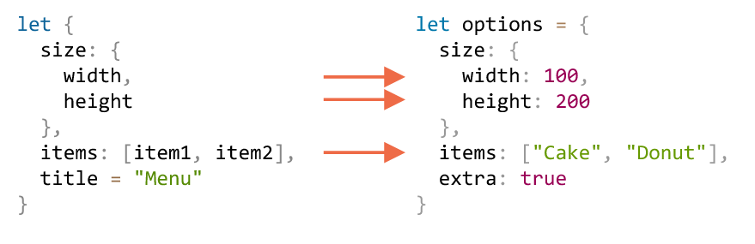
Nested destructuring
If an object or an array contain other nested objects and arrays, we can use more complex left-side patterns to extract deeper portions.
In the code below options has another object in the property size and an array in the property items. The pattern at the left side of the assignment has the same structure to extract values from them:
Let options={
size:{width:100,height:200},
Items:[“Cake”,”Donut”],
Extra:true;
}
// destructuring assignment split in multiple lines for clarity
let {
size: { // put size here
width,
height
},
items: [item1, item2], // assign items here
title = "Menu" // not present in the object (default value is used)
} = options;
alert(title); // Menu
alert(width); // 100
alert(height); // 200
alert(item1); // Cake
alert(item2); // Donut
All properties of options object except extra that is absent in the left part, are assigned to corresponding variables:
Finally, we have width, height, item1, item2 and title from the default value.
Note that there are no variables for size and items, as we take their content instead.

